Slide 1
GROUP 3
CMPE 273 | SHIH YU CHANG
WILLIAM BARON
TIFFANY LEE
EMMA PEATFIELD
YUDHVIR SINGH
STERLING TARNG

Slide 2
CHALLENGE DESCRIPTION - URL PARSING
Company XYZ is an Online Travel Agent site, such as Expedia, Booking.com, etc.
They haven't invested in data science yet and all the data they have about user searches are simply stored in the URLs generated when users search for a hotel.
There is valuable information about what customers search for, what amenities they value most, and what locations are trending in these searches
Notes:
You are asked to:
Create a clean data set where each column is a field in the URL, each row is a given
search and the cells are the corresponding URL values.
For each search query, how many amenities were selected?
Often, to measure the quality of a search algorithm, data scientists use some metric
based on how often users click on the second page, third page, and so on. The idea here
is that a great search algorithm should return all interesting results on the first page and
never force users to visit the other pages (how often do you click on the second page
52
results when you search on Google? Almost never, right?).
Create a metric based on the above idea and find the city with the worst search
algorithm.

Slide 3
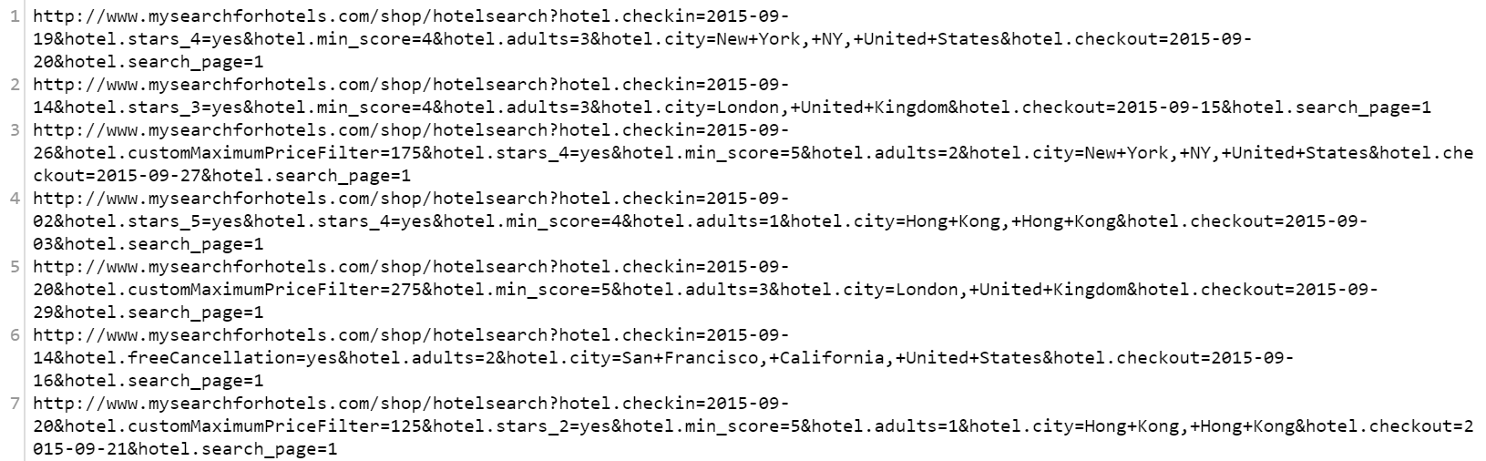
URL SNAPSHOT
Notes:
-create easily manageable searchable data set format
So we can easily see what the most popular searched for amenities, locations, etc, are

Slide 4
PROPOSED SOLUTION/CONSIDERATIONS
Create a table that takes in all the variable information from the URLs and display in an easy to read format, easy to query
From our table, can use database queries and metric algorithms to meet the analytic needs of the user
Not every URL has optional search criteria (i.e., amenities, min score)
Important to consider finding the most optimal way to parse the information in a clean and efficient manner as we are searching through a large data set

Slide 5
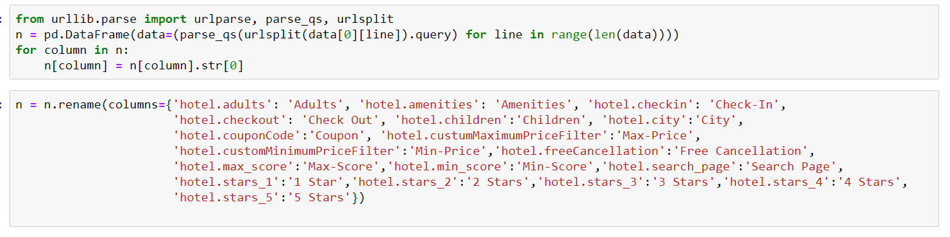
PROCESSING THE URLs

Slide 6
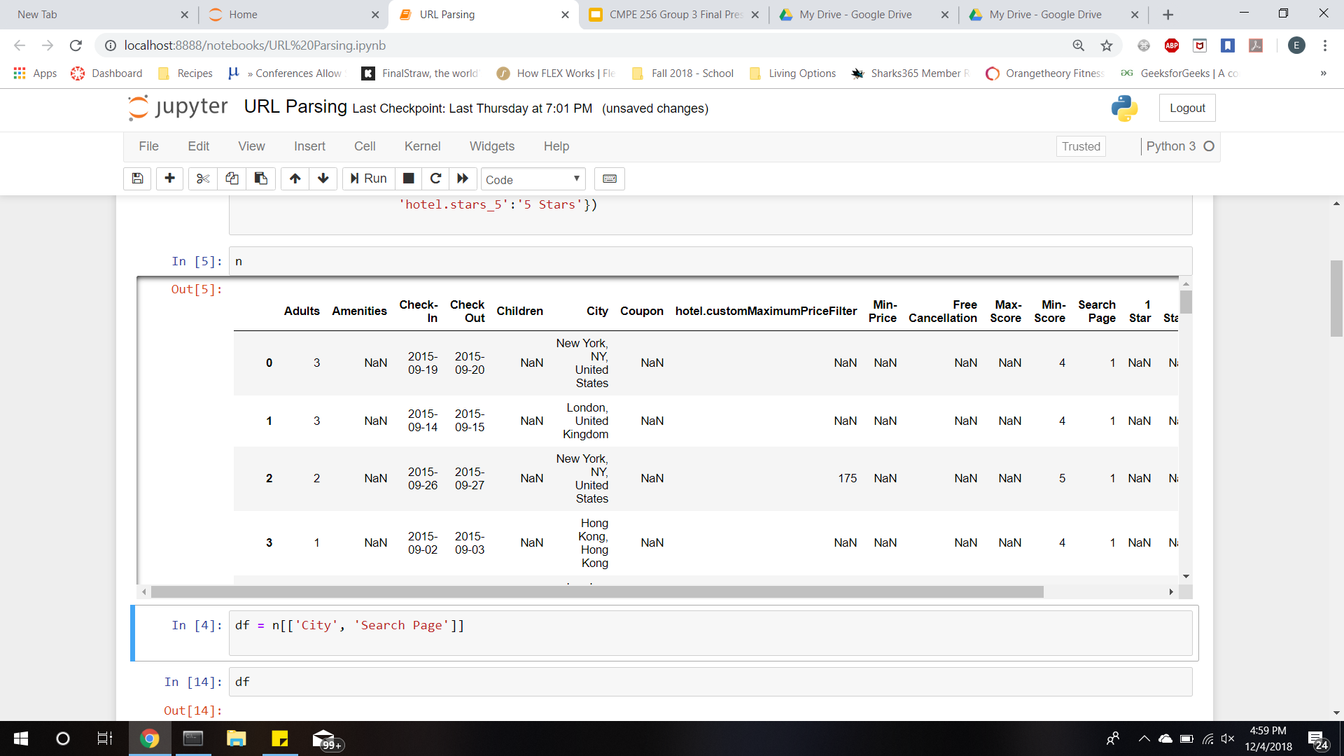
DATA TABLES AFTER PARSING

Slide 7
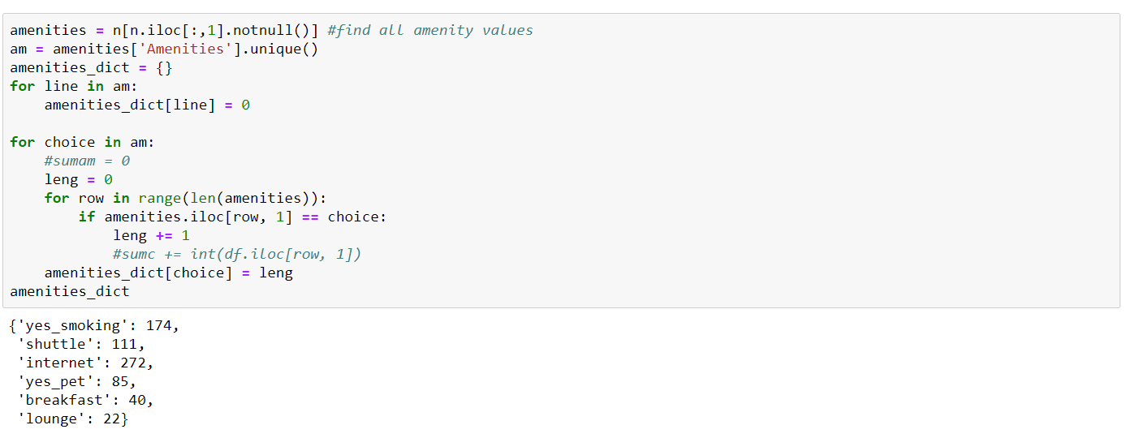
FINDING THE AMENITIES

Slide 8
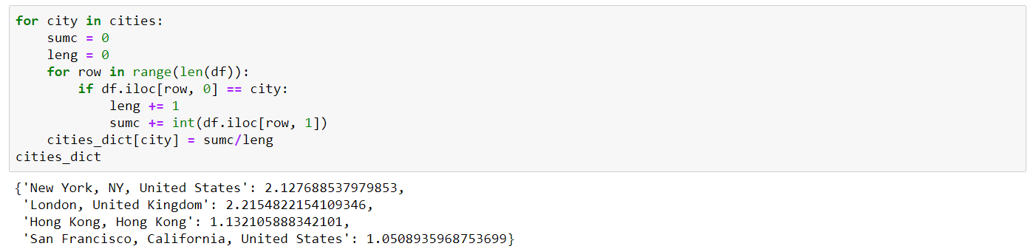
WORST SEARCH CRITERIA

Slide 9
CHALLENGES
Game Plan for how to parse the URLs in optimal searchable format
Deciding which metric to use as the worst search criteria

Slide 10
CHALLENGE DESCRIPTION - DIVERSITY IN THE WORKPLACE
Looking for signs of discrimination or bias in how companies treat their employees is a difficult and unclear task.
We can use data science techniques to help us find these signs of discrimination.
Notes:
Problem: Looking for signs of discrimination or bias in how companies treat their employees is a difficult and unclear task.
Unfortunately, this problem is not only a serious one but is also relevant in today’s society.
Thankfully, we can use data science techniques to help us find these signs of discrimination.

Slide 11
PROPOSED SOLUTION
Determine the relevant features from our employee data
Build and run our prediction model to predict salary.
Determine the importance of each feature relative to the others
Notes:
Registration: Name & Student ID
Each phone has unique ID, so cannot ‘pretend’ to be someone else
Difference between provisioning and configuration on exam: element manager functions
Fault management 3 functions on exam
Can choose the time period that the beacon detects and updates roster
Minimum user Interaction
Dashboard to Query the database.

Slide 12
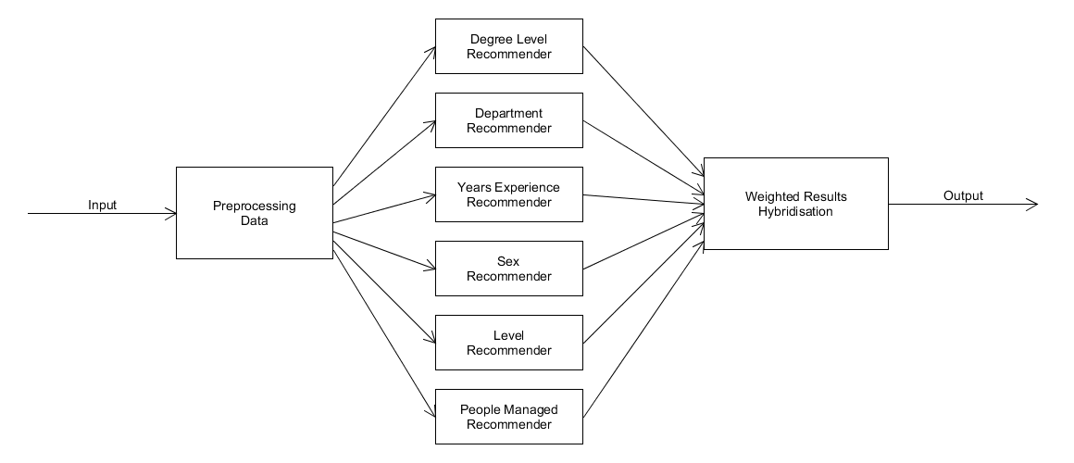
OLD PREDICTION MODEL
Notes:
Registration: Name & Student ID
Each phone has unique ID, so cannot ‘pretend’ to be someone else
Difference between provisioning and configuration on exam: element manager functions
Fault management 3 functions on exam
Can choose the time period that the beacon detects and updates roster
Minimum user Interaction
Dashboard to Query the database.

Slide 13
RANDOM FOREST PREDICTION
A random forest is a combination of decision trees
Decision trees are build as a series of questions that narrows the possibility to make a confident decision
The order of the questions can change and thus the final decision may change with it.
A random forest is the collection of many decision trees by put together in a single model that is able to combine decision of all the decisions trees created
Notes:
Registration: Name & Student ID
Each phone has unique ID, so cannot ‘pretend’ to be someone else
Difference between provisioning and configuration on exam: element manager functions
Fault management 3 functions on exam
Can choose the time period that the beacon detects and updates roster
Minimum user Interaction
Dashboard to Query the database.

Slide 14
PREPROCESSING DATA
Determine the level of each employee
Determine how many employees each person manages
Encode values for non-numeric features
One hot encoding of gender departments

Slide 15
Preparation of Data for Training and Testing
Data preparation is done by splitting data into
Training sets and
Testing sets
We randomly split the data to get a representation of all data points.
Randomly splitting the data makes algorithm perform better.
The training features number of columns and rows should match the testing feature number of columns and rows for respective training and testing feature.

Slide 16

Prediction and Error Calculation
Run Forest Prediction Model on the Test Data
Calculate Mean Absolute Error (MAE)

Slide 17
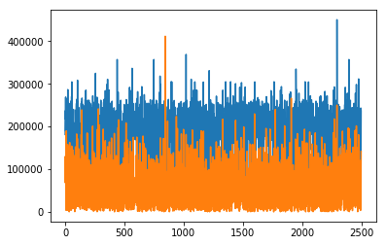
Prediction and Error Calculation (cont.)
Mean Absolute Error: $57, 531.89
Salary Standard Deviation: $88,973.80

Slide 18
CHALLENGES
Analysing the data to find the best model
Traversing the data in the most efficient way to get the values for prediction
Deciding the best cut between training data and testing data for better results
Adjusting the ‘hyper-parameters’ of the random forest to get better results.

